Slide 1

Functional First Refactoring
Practical problem-solving
Christina Smithers, Software Engineering Seito
Notes:
Received ticket to test out and refactor in Java legacy code

Slide 2
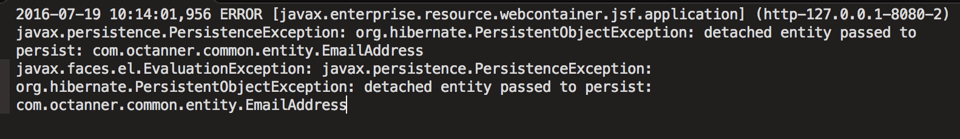
Issue
Inputs are taken, but get discarded
Notes:
After recreating the issue, it was found that the email subject gets updates, email body gets updates, but the email name does not.
Backend framework called persist on the entity but it did not persist
Ice faces framework is like Google web toolkit but made to work with our stuff in Java
Seam Apps is the framework that PerfCommon has built in

Slide 3
Beginning Process
As a developer…
Find the issue in the code and reproduce it with a failing test
refactor it
Test the inverse
Prove hypothesis with a passing test
Ship it
Notes:
After running the existing integration and then unit tests, got a null where not expected so it was time to write a failing test

Slide 4
The actual stages of FFR
Find the issue in the code and reproduce it with a failing test

Slide 5
The actual Stages of FFR
Refactor

Slide 6
The actual Stages of FFR
Test and test inverse

Slide 7
The actual Stages of FFR
It passes, time to ship!

Slide 8
Refactoring – An Ancient Solution to complex problems
Origin from Algebra (from Arabic "al-jabr" meaning "reunion of broken parts”
Diophantus of Alexandria and Al-Khwarizmi of Persia
Programming driven by logical thinking
Behavior and test driven
Leads to correctness and clean code
“Leave it better than you found it”
Notes:
Diophantus and Al-Khwarizmi

Slide 9
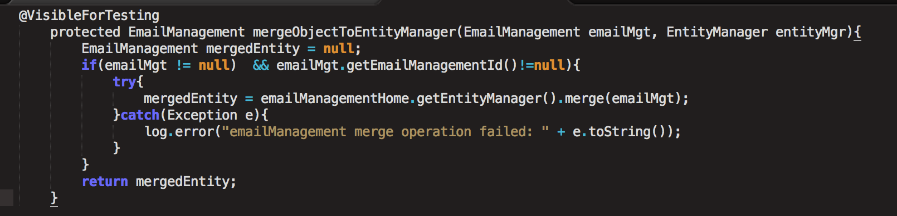
Source of current behavior
Notes:
EntityManager merge extends the Seam code
Drilled down to this so we can get the localized problem exposed

Slide 10
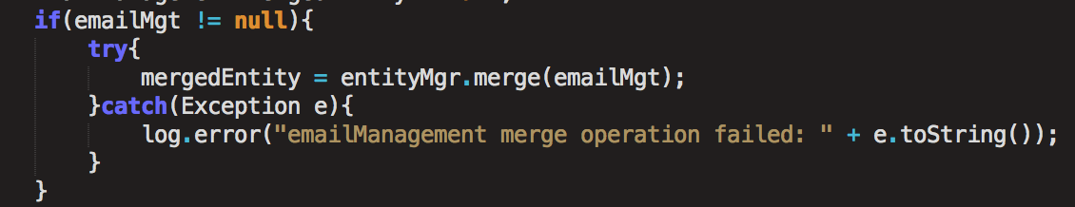
Predict outcomes for test Development
Notes:
Utilized the try catch to help see where it goes into this if statement to catch the error
Passed through IF and passed null because it didn’t persist null
Current setup ID is null

Slide 11
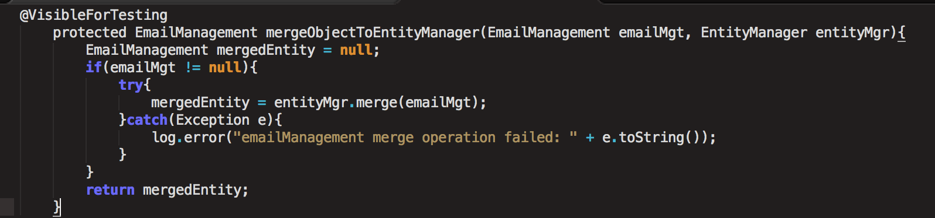
After recreation

Slide 12
Functional First and testing
Characterization
Deliberate and doesn’t introduce new problems
Reduce duplication
Good names (long if necessary)
Notes:
Precondition
Side-effecting
Outcome

Slide 13
One thing at a time
One test class for ONE object implementation
Comment out parts, explore, and localize
Match tests to names of methods
Notes:
One test class for one object implementation
Matching tests names to methods – testMergeObjectToEntityManager …Unpersisted became TestMarged...PassedToUnpoersisted. Do it before nad after class so you can temporarily introduce things you don’t like such as duplications and use it to move in the correct direction

Slide 14
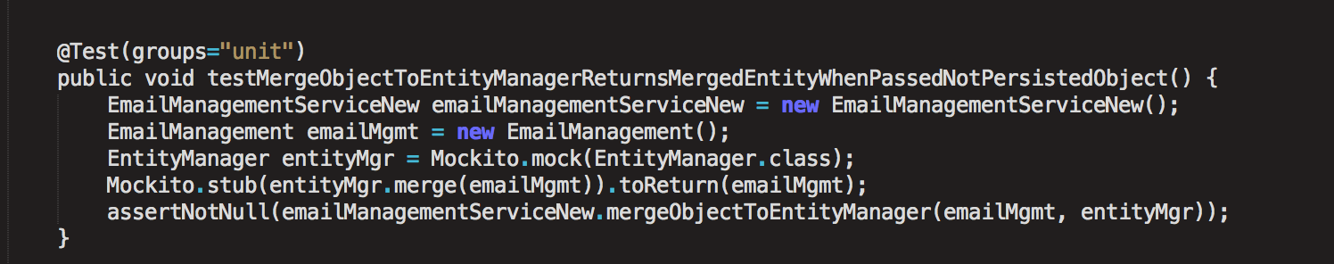
Test a Behavior

Slide 15
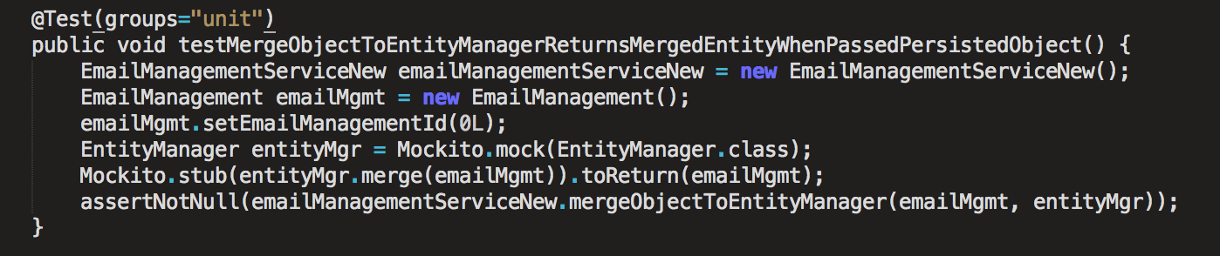
Test the Inverse

Slide 16
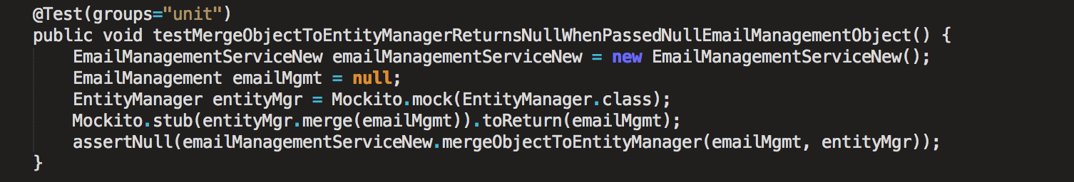
Further Testing branches
A.k.a. “Moar Testing!!!!111eleventyone”
Notes:
Intentionally leaving behavior as it is b/c allows alternatives to be considered
Writing test to show what it is doing
In this example allows branches of a conditional to be checked
Helps avoid latent bugs which don’t surface until much later thus making us confident in our code

Slide 17
Refactor all the Values
Functions are first-class values
Map inputs to outputs
Caution: it can be used outside of programming and math
Notes:
Technical Debt = time increase for energy to understand the code
If you spend time learning the things you now understand, refactor them because it closes the gap to get what’s happening in the code into our heads quickly, reduces errors and introduces higher quality code and avoids mocking
“Functional programming is guided by two main ideas. The first idea is that functions are first-class values... You can pass functions as arguments to other functions, return them as results from functions, or store them in variables...
The second main idea of functional programming is that the operations of a program should map input values to output values rather than change data in place.”
-Odersky, Spoon, and Venners
Make smaller tests (aka Unit) because it saves time and is easier to fix.
Direct isolation leads to the part that is breaking withing in a range and htus can form focused tests

Slide 18
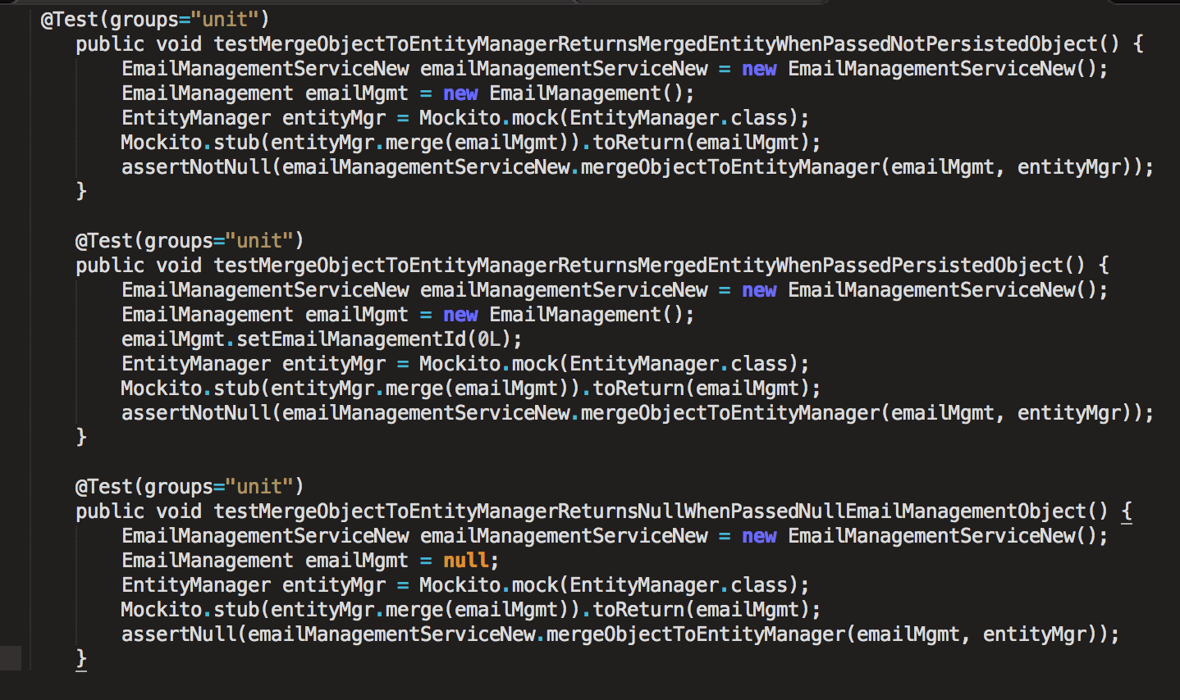
Final Passing test
Notes:
Now asserting notNull so we can predict pass/fail error message which tells us what is wrong
Unit v integrated – safety nets. Integrated covers more area but more slips through whereas unit is finer but only takes on a small bit at a time

Slide 19
Refactoring Key points
Test current behavior with descriptive name before test
Predict Outcomes
Test outcome inverse
Speed up tests
Discovering behavior
Using IDE for running tests
Test without mocks where possible
Smaller tests
ANNOTATE
Notes:
If not solving the problem, keep running tests since it keeps getting closer to solving the problem but undo changes, make your hypothesis and try again
Isolate the unique business logic as much as possible so frameowrks only relied on minimally

Slide 20
Summary
FFR Cycle

Slide 21
Thank You!
McKinley
Aros
Rob
Dan
Pat Maddox
Utah Software Craftsmen Meetup Group
O.C. Tanner community

